Slide 1
The study of Google’s Cartographer
From Real-Time Loop Closure in 2D LIDAR SLAM
To IMPROVING GOOGLE’S CARTOGRAPHER 3D MAPPING BY CONTINUOUS-TIME SLAM
张旭东

Slide 2
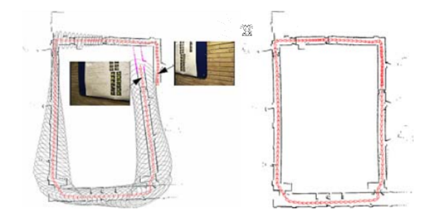
What is loop closure detection of SLAM?
= constraints
Accumulation of error
Without loop closure
With loop closure

Slide 3
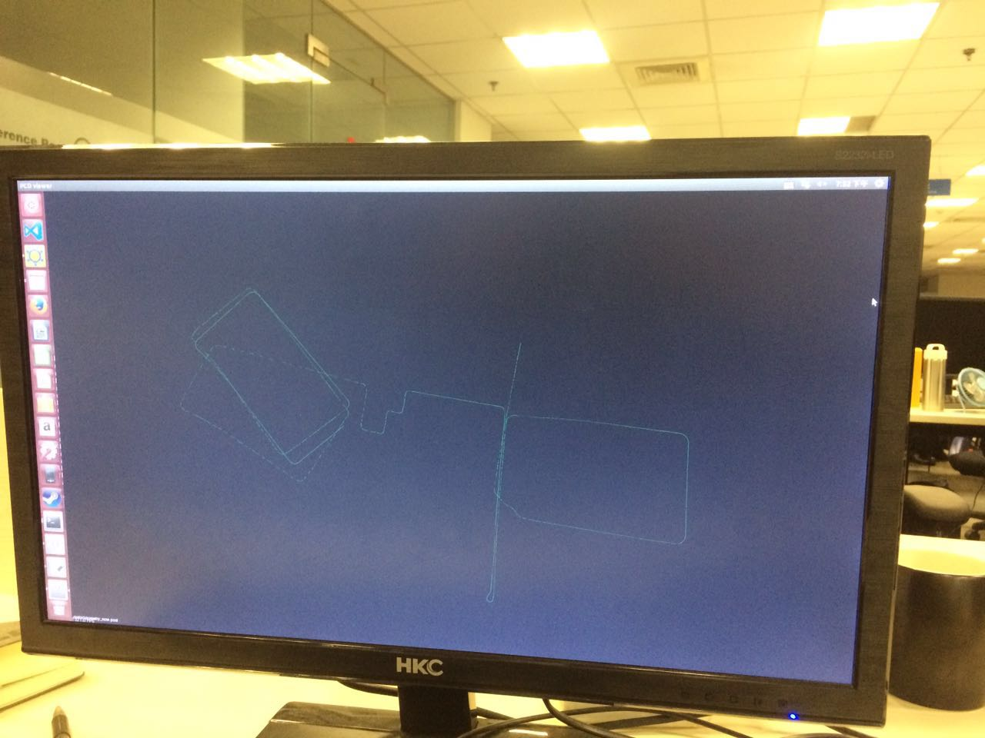

What trouble we have

Slide 4
Classification of SLAM (lidar)
Scan-to-scan
Scan-to-map
Pixel-accurate scan
LOAM
Computational
Complexity
accumulation
error
Loop closure detection
Main problem

Slide 5
What does Cartographer do?
1. Loop closure detection using submaps
2. Reduce computational complexity using branch-and-bound scan matching
Notes:
分支界限

Slide 6
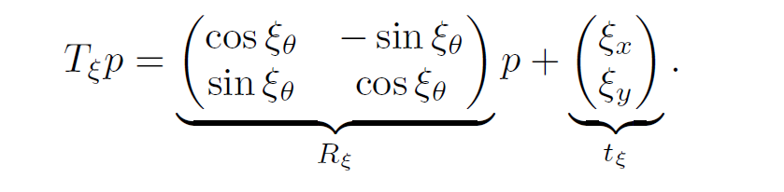
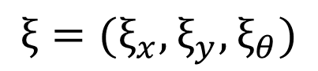
What is the submap?
Discussion with the 2d lidar point cloud
$$ξ=(ξ_{x},ξ_{y},ξ_{θ})$$
translation
rotation

Slide 7
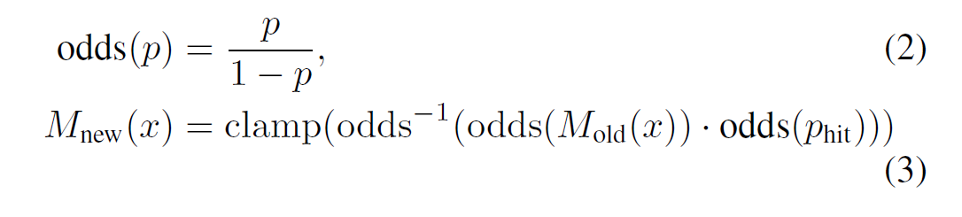
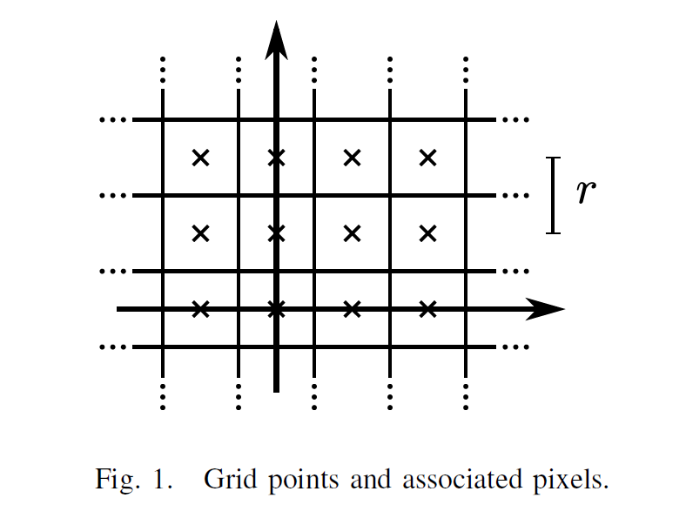
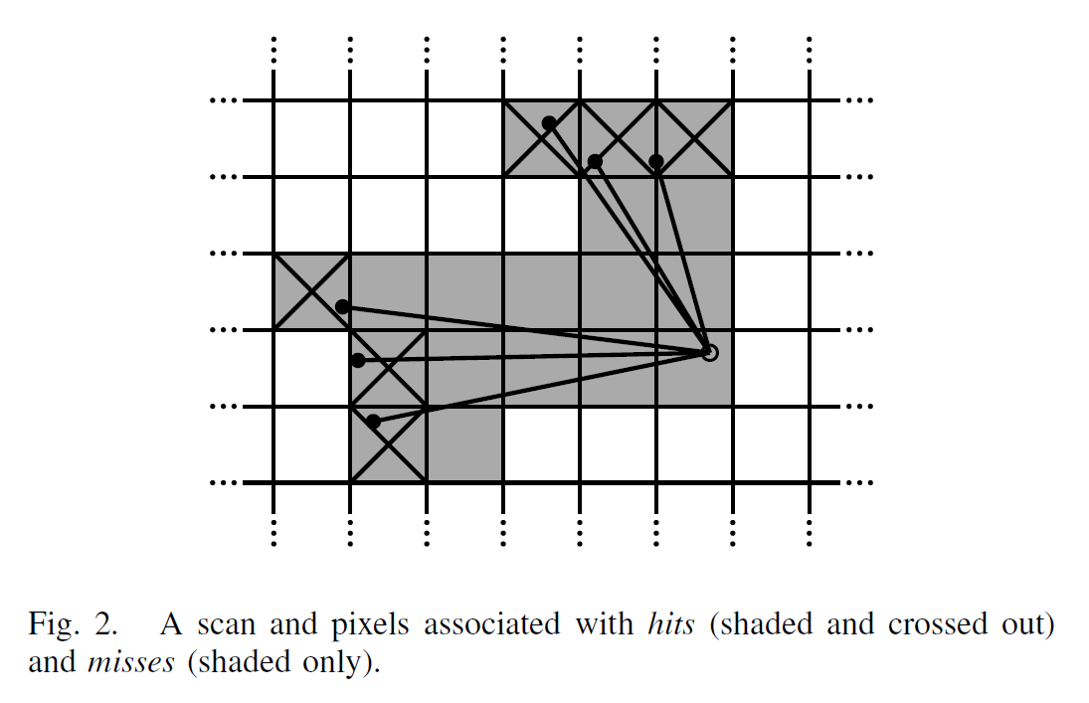
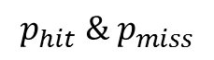
What is the submap?
& equivalently for misses.
$$p_{hit} \& p_{miss}$$

Slide 8
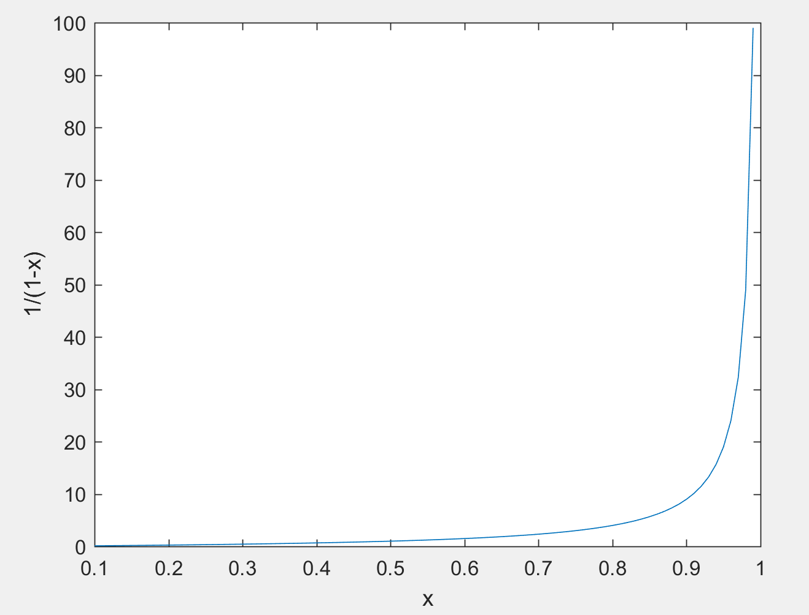
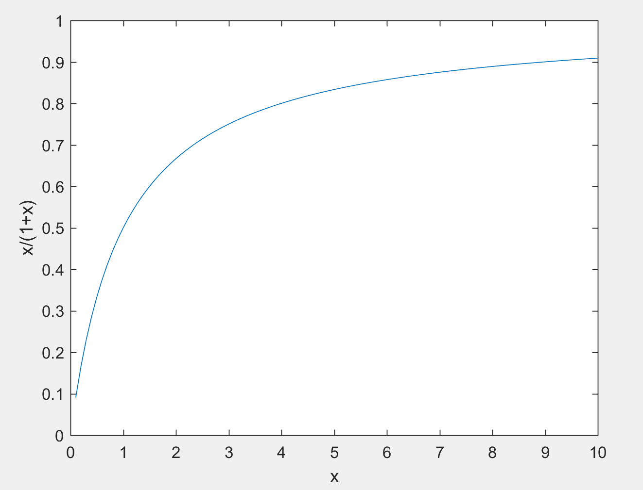
What is the submap?
& equivalently for misses.
$$odds\left(x\right)=\frac{x}{1−x} {odds}^{−1}\left(x\right)=\frac{x}{1+x}$$

Slide 9
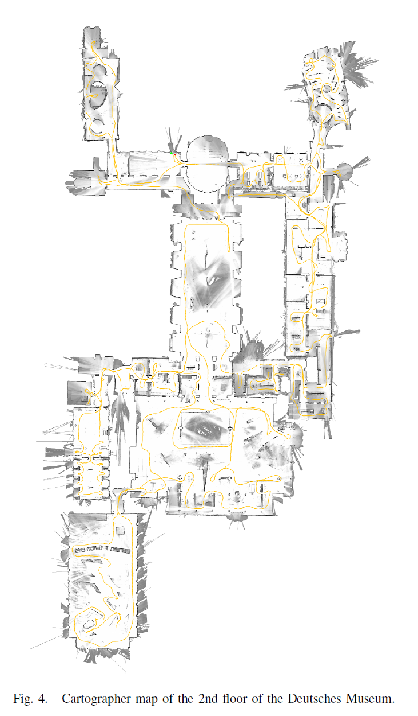
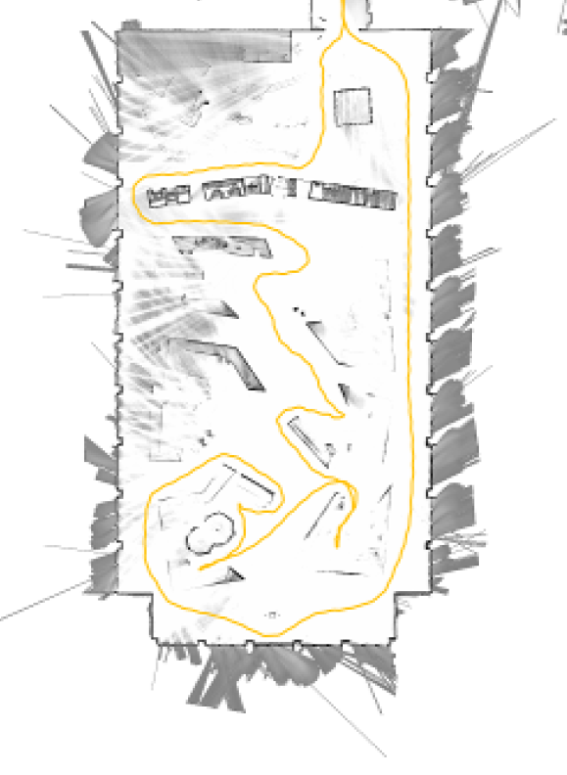

Slide 10
Classification of SLAM (lidar)
Scan-to-scan
Scan-to-map
Pixel-accurate scan
LOAM
Computational
Complexity
accumulation
error
Loop closure detection
Main problem

Slide 11
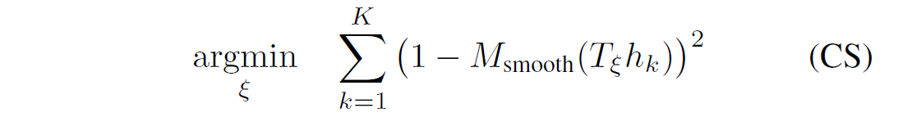
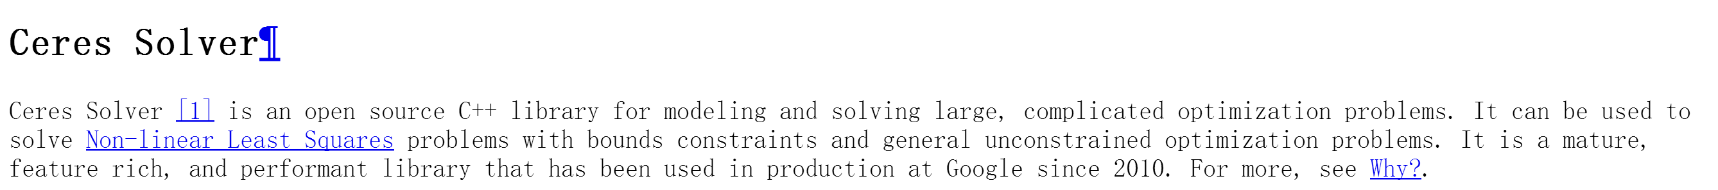

How to produce submaps?
Ceres scan matching
$$≈ICP$$
Open source

Slide 12
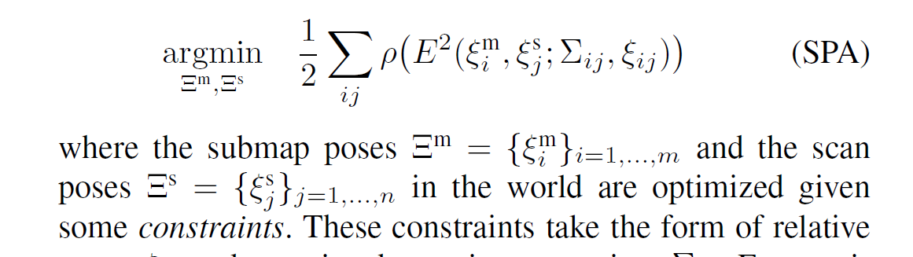
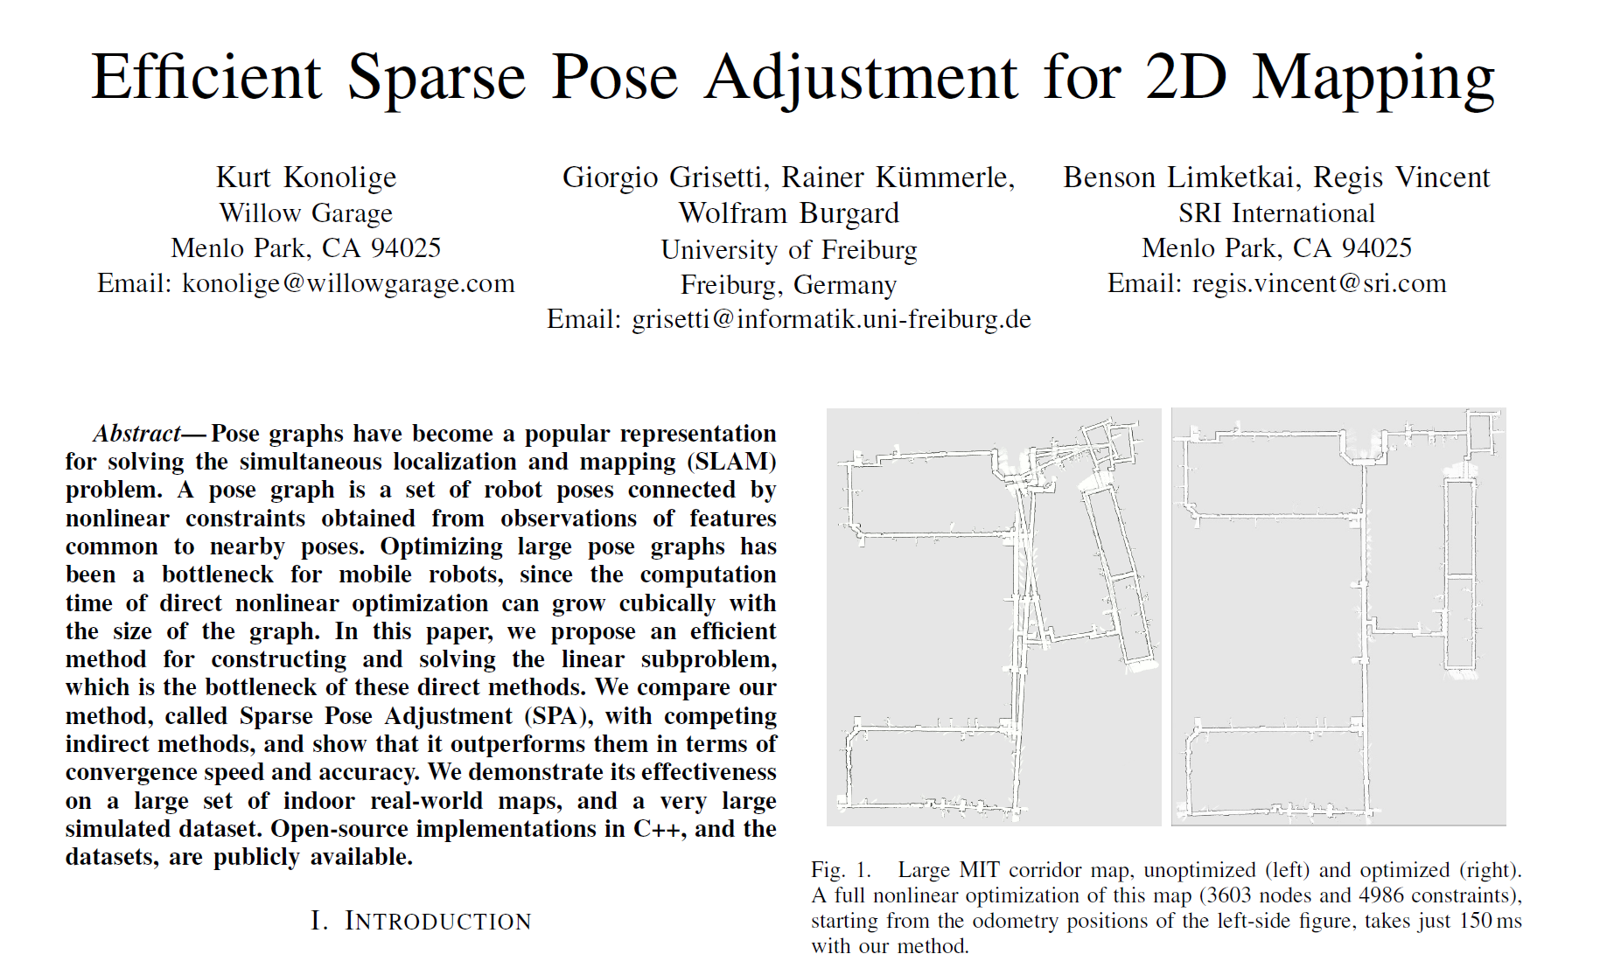
What is the loop closure of Cartographer?
SPA

Slide 13
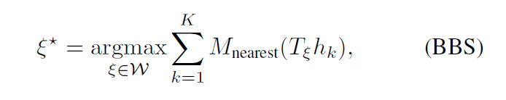
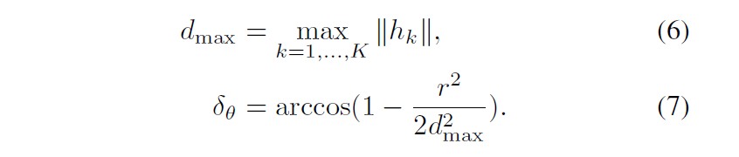
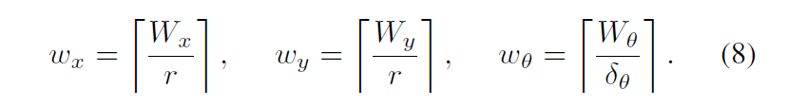
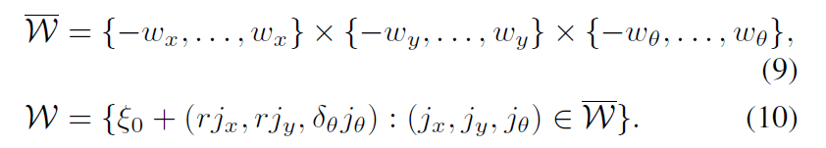
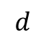
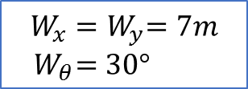
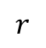
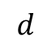
How to make it fast?
Branch-and-bound scan matching → efficiency
$$r$$
$$W_{x}{=W}_{y}=7m$$
${ W}_{θ}=30°$
$$d$$
$$d$$
Notes:
分支界限算法 解空间搜索 对submap使用

Slide 14
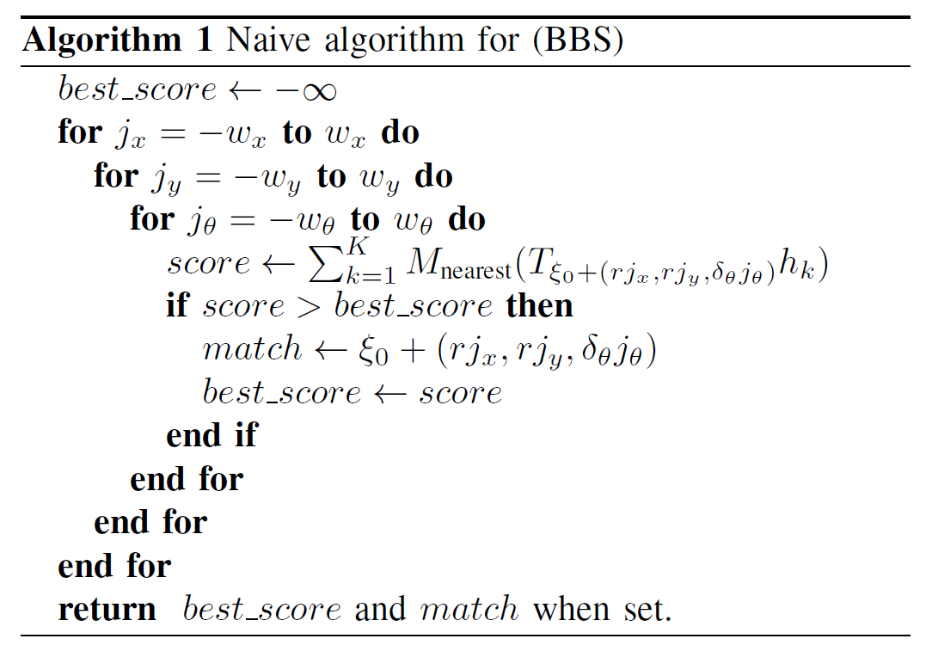

Slide 15
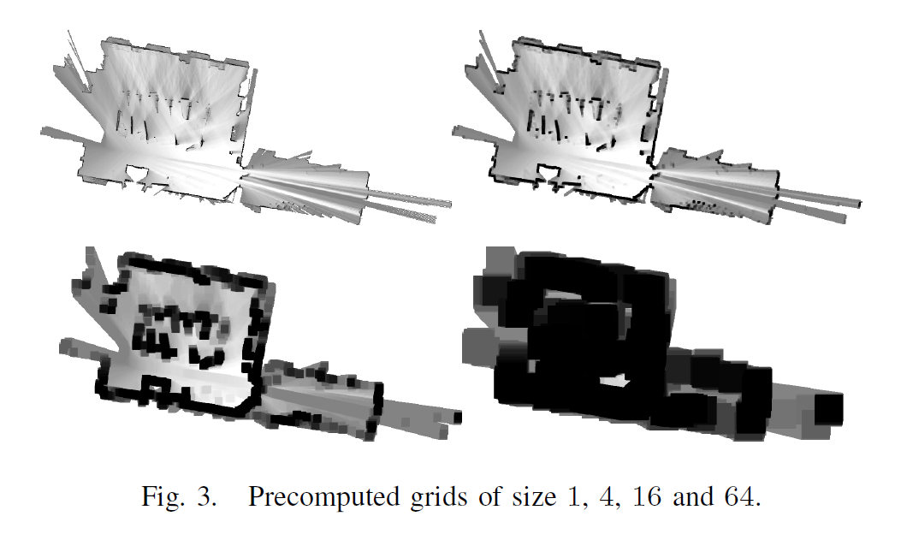
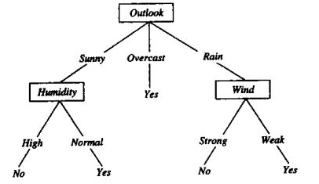
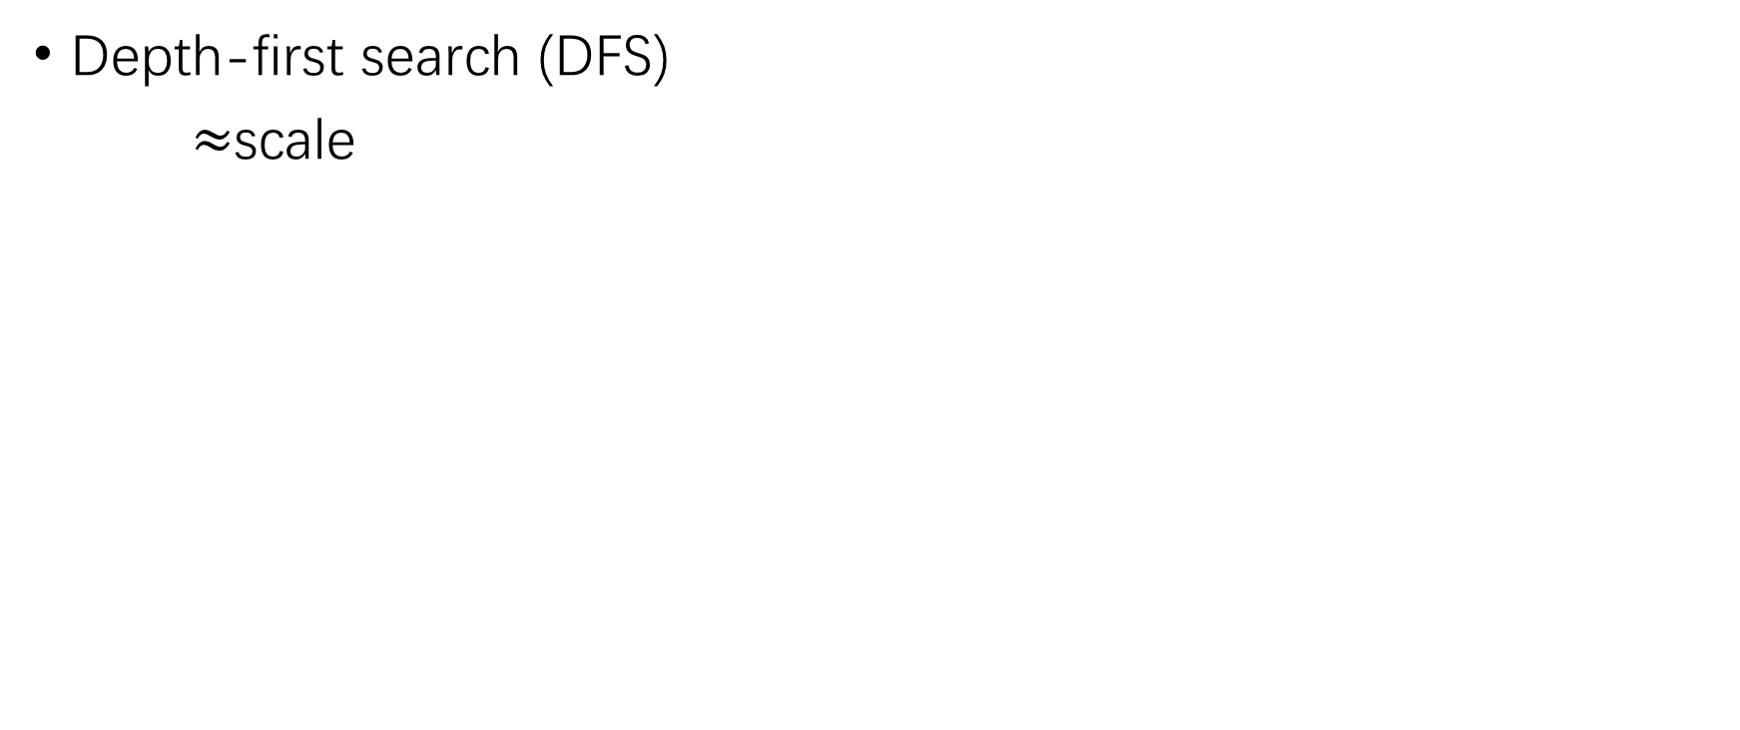
Is it fast enough?
Depth-first search (DFS)
$≈$scale

Slide 16
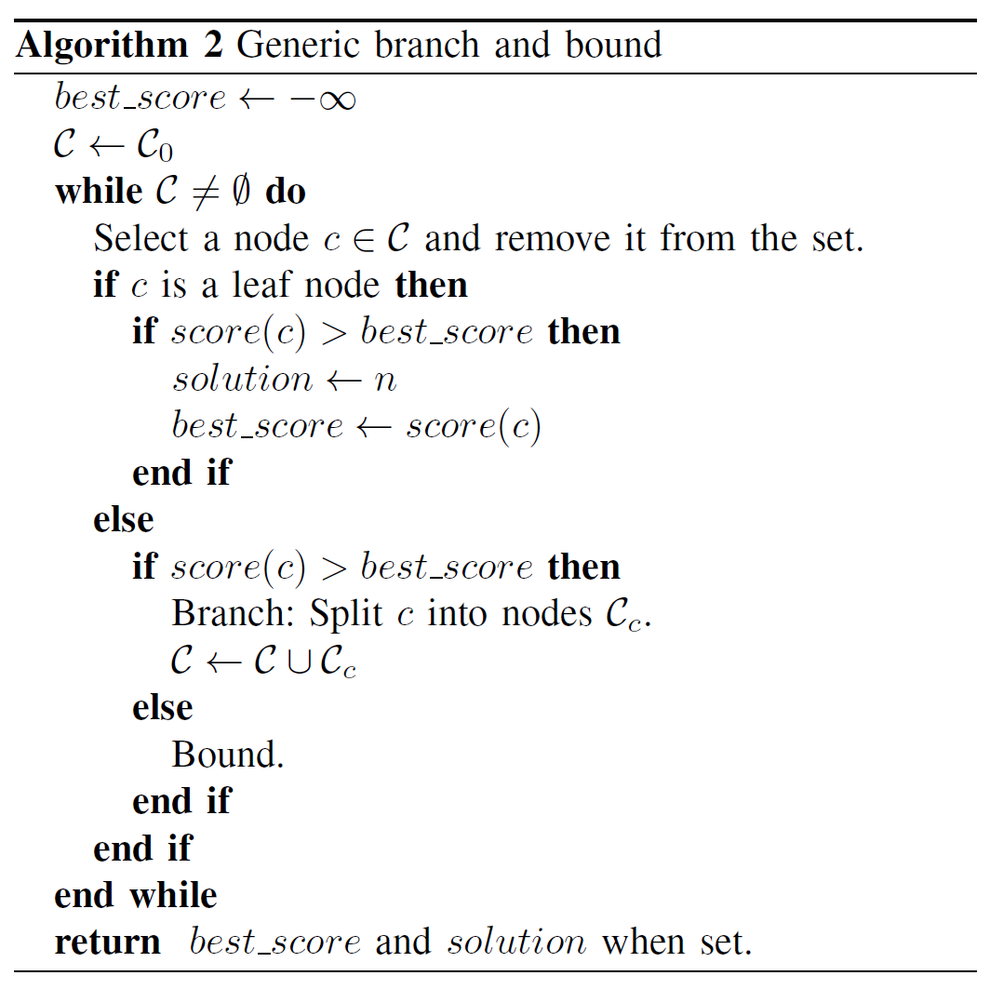
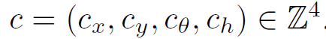
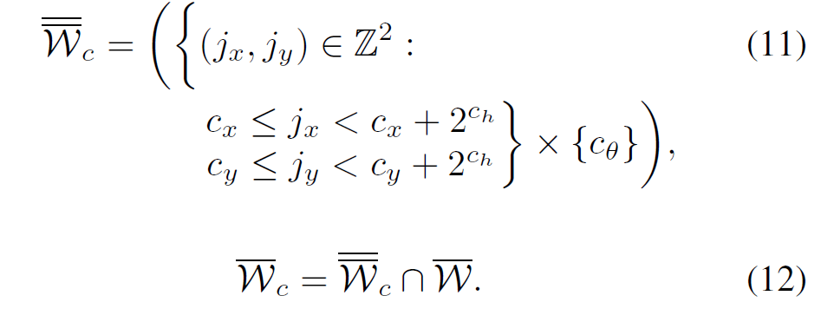
Details?

Slide 17
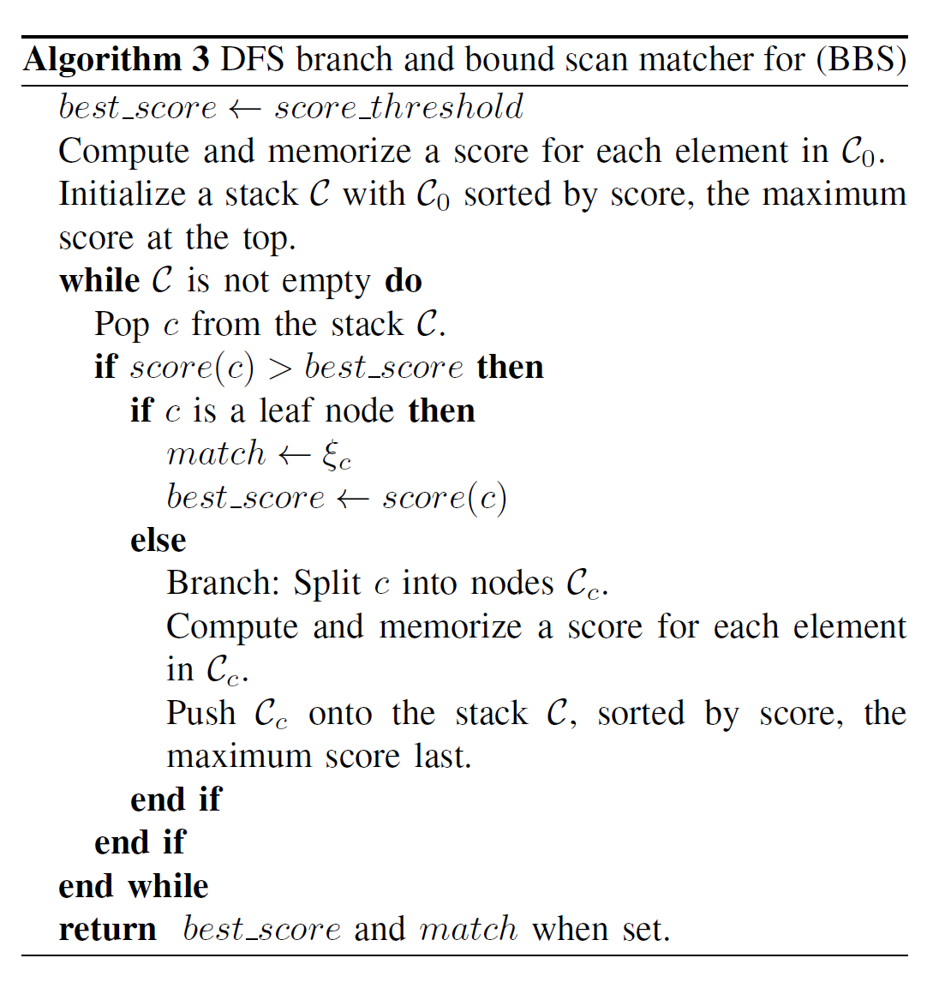

Slide 18
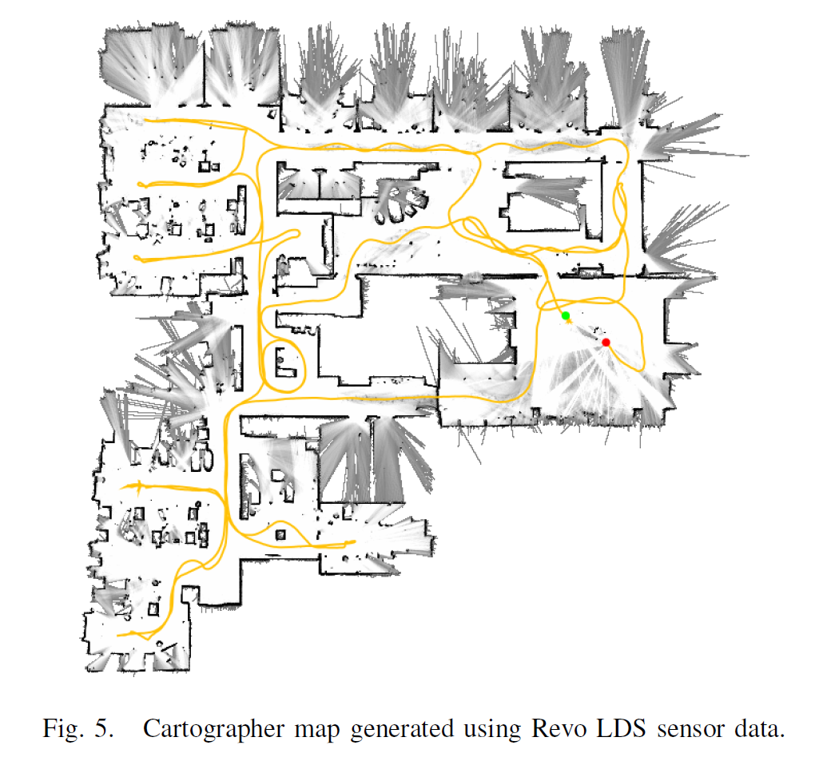
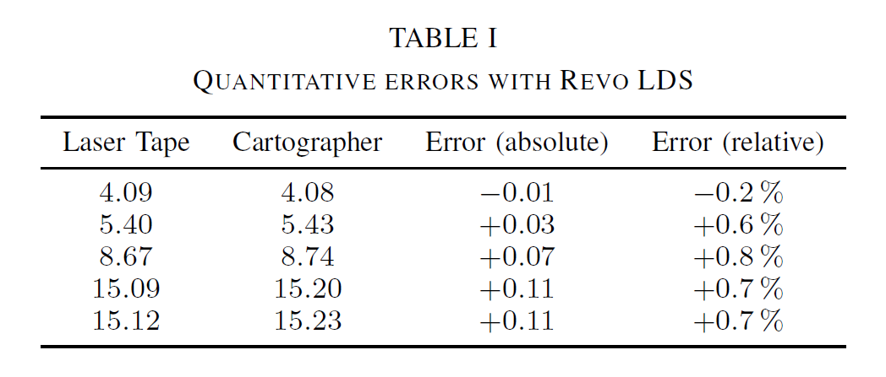
Is it effective?

Slide 19
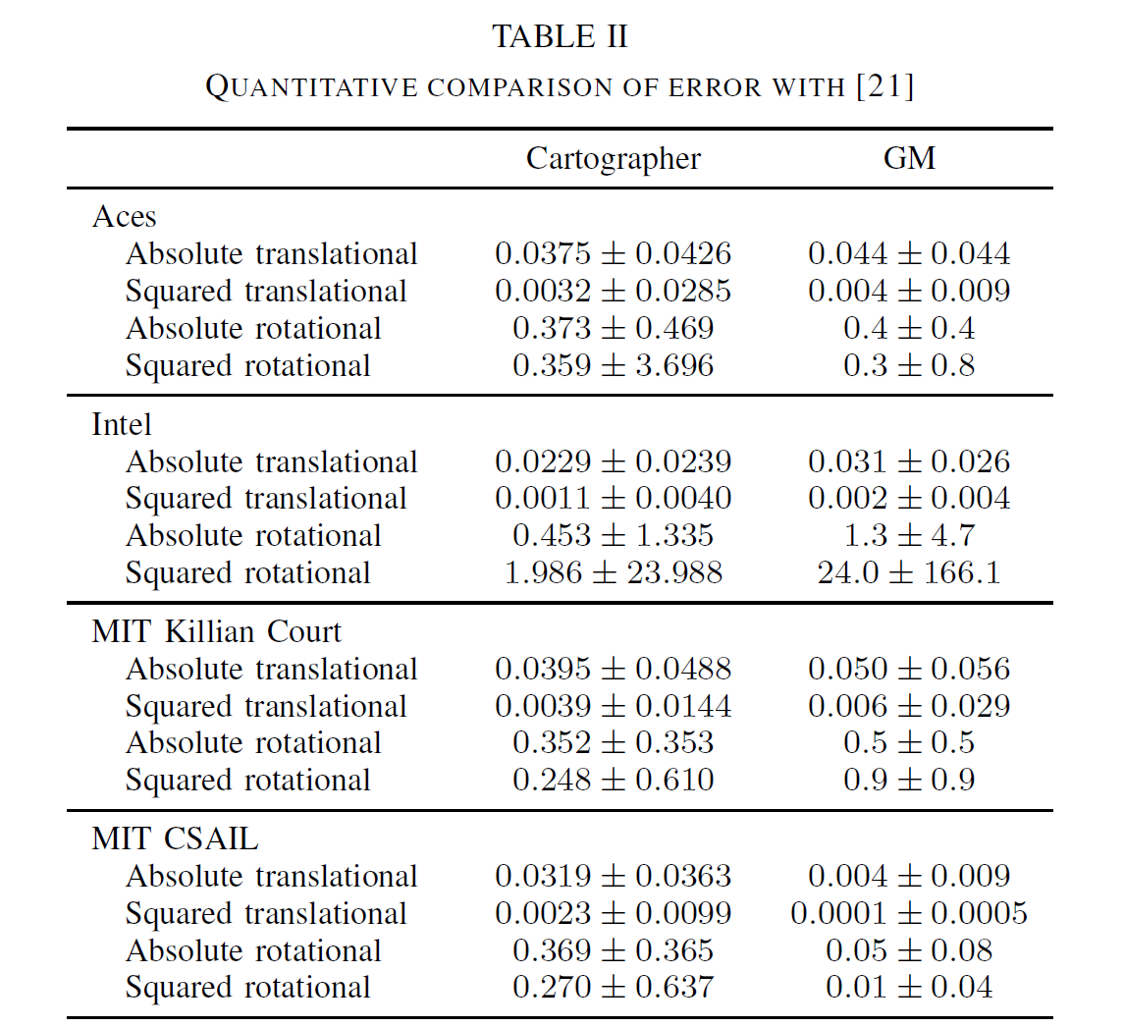
Graph Mapping

Slide 20
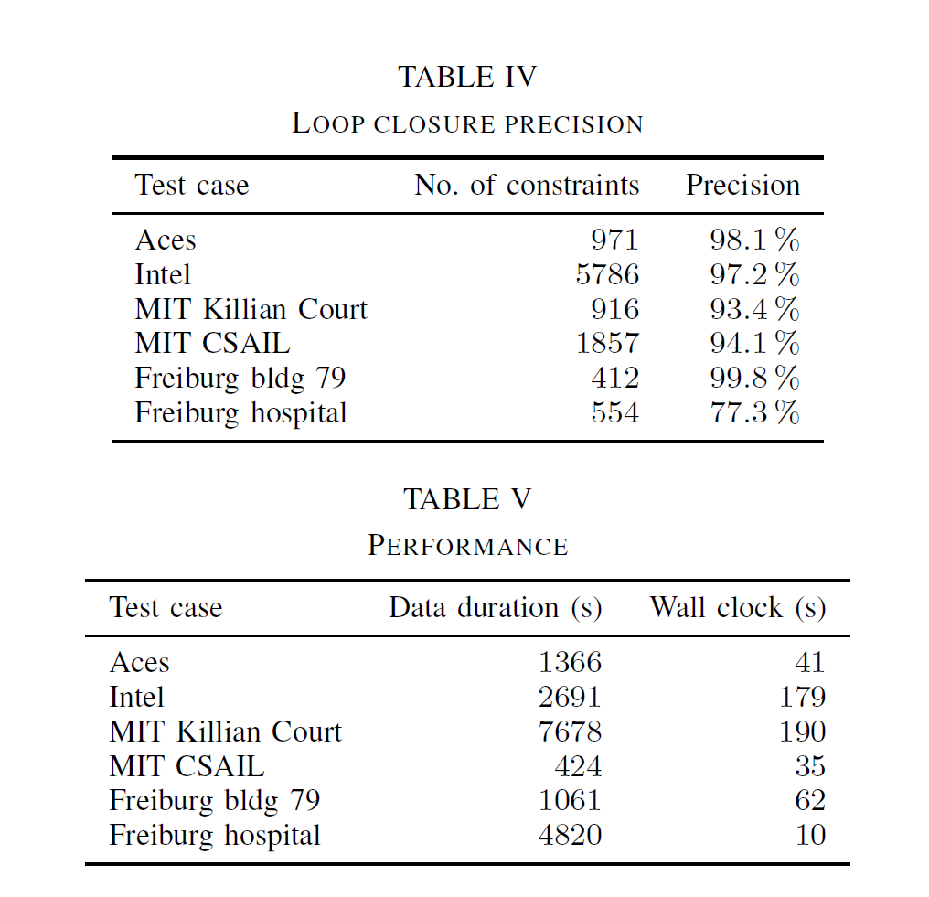

Slide 21
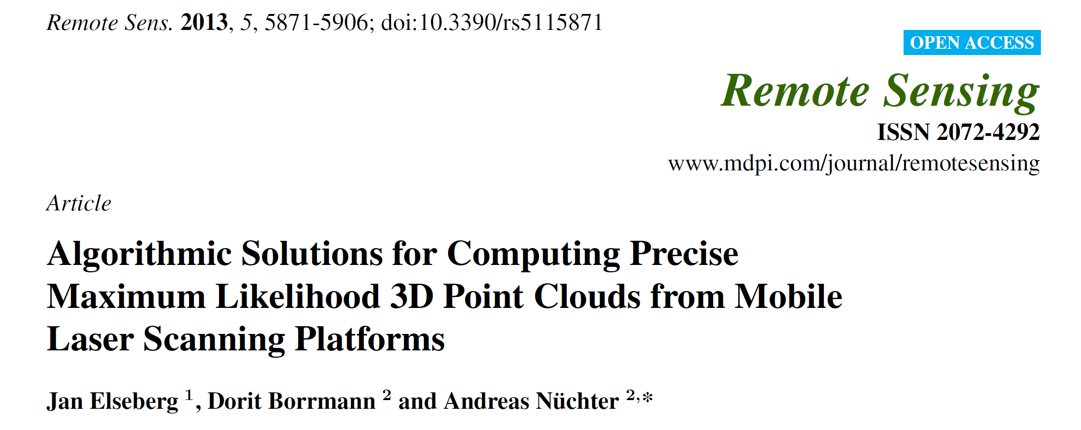


Slide 22
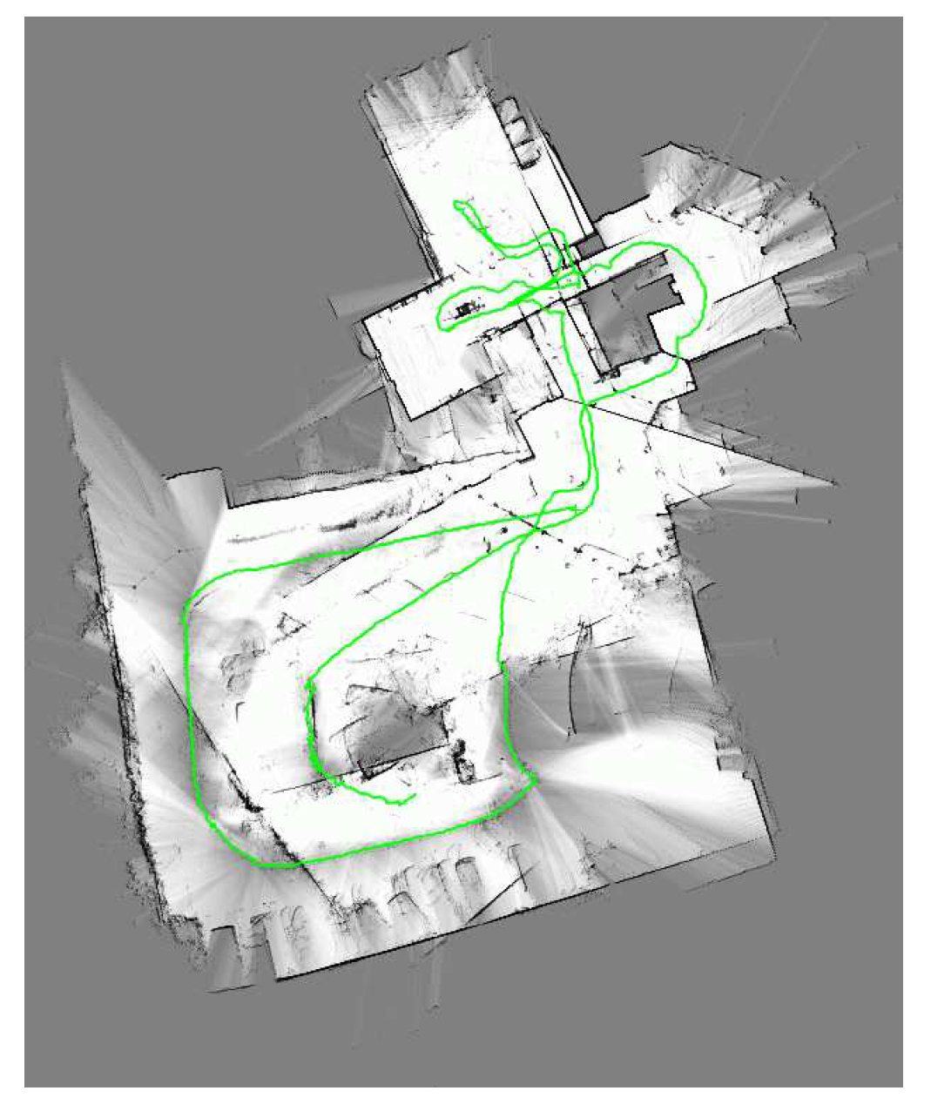
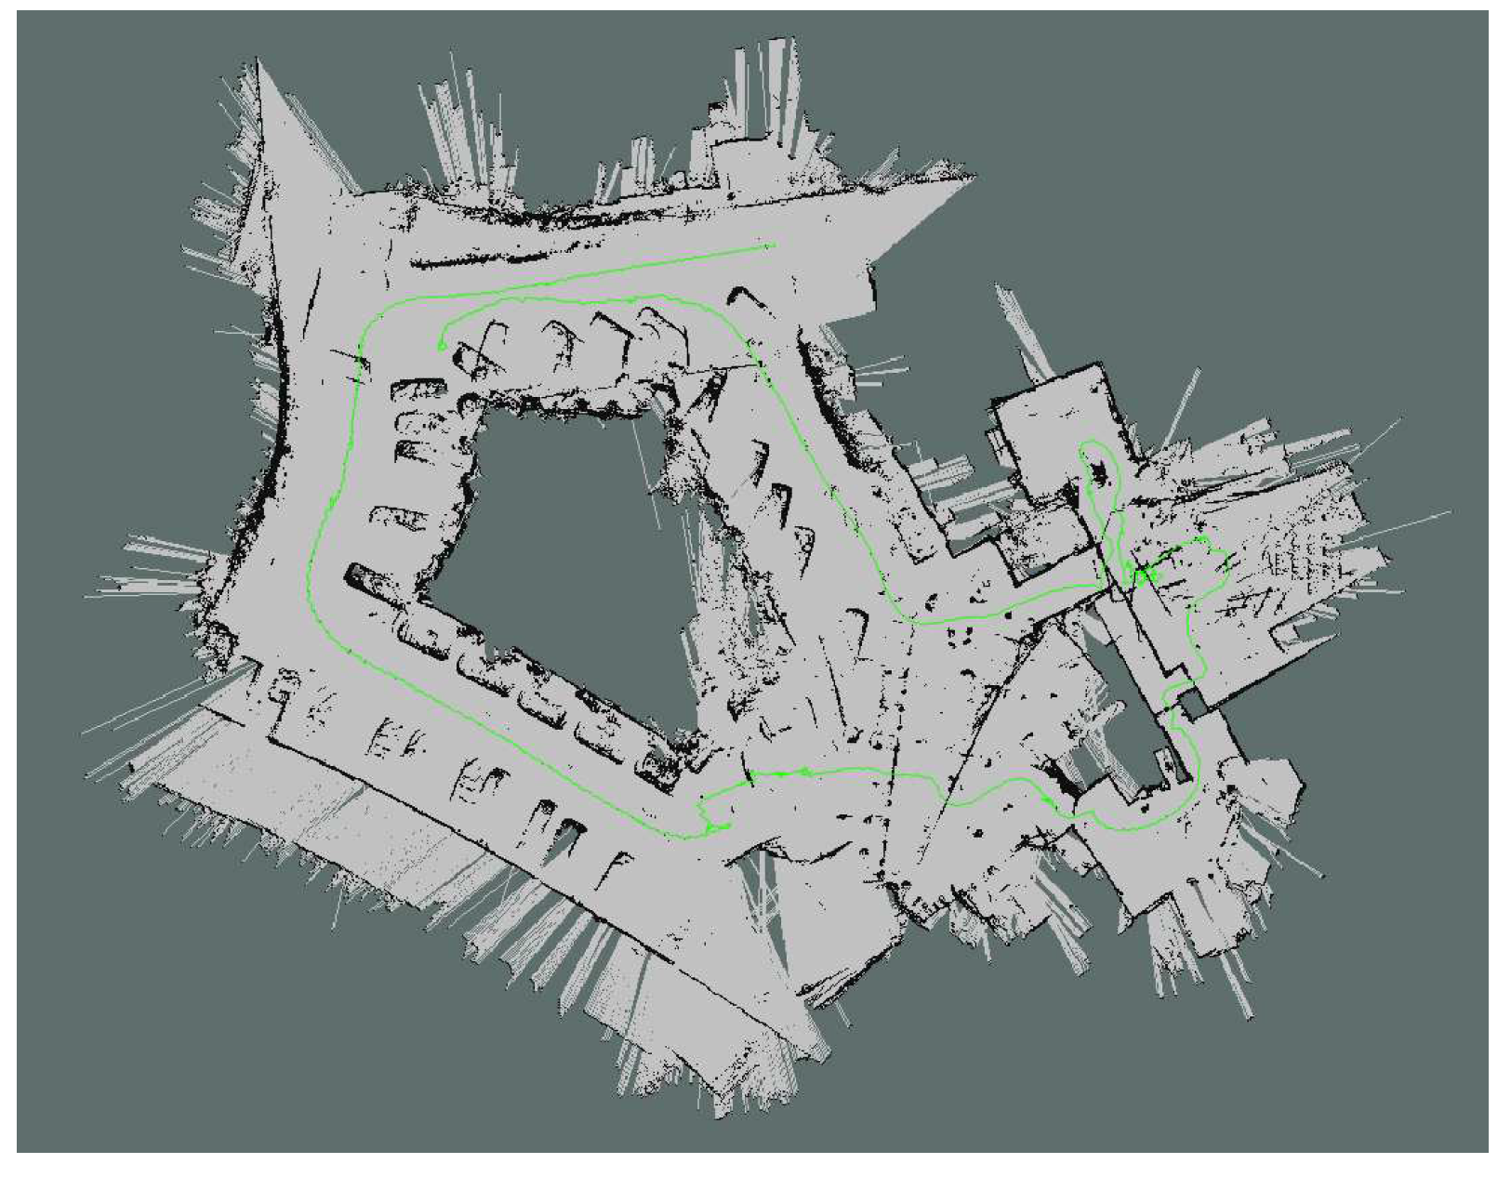
How does it work with 3D point cloud?
Notes:
准 gps

Slide 23
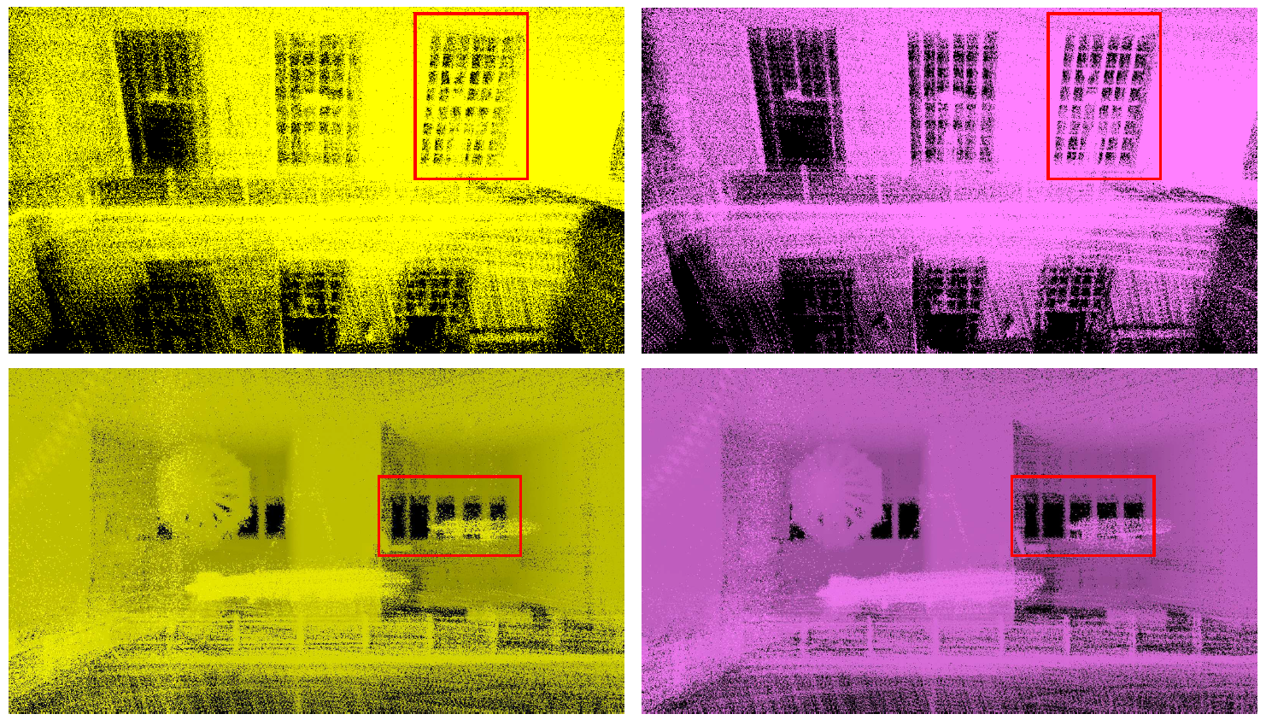
How does it work with 3D point cloud?

Slide 24
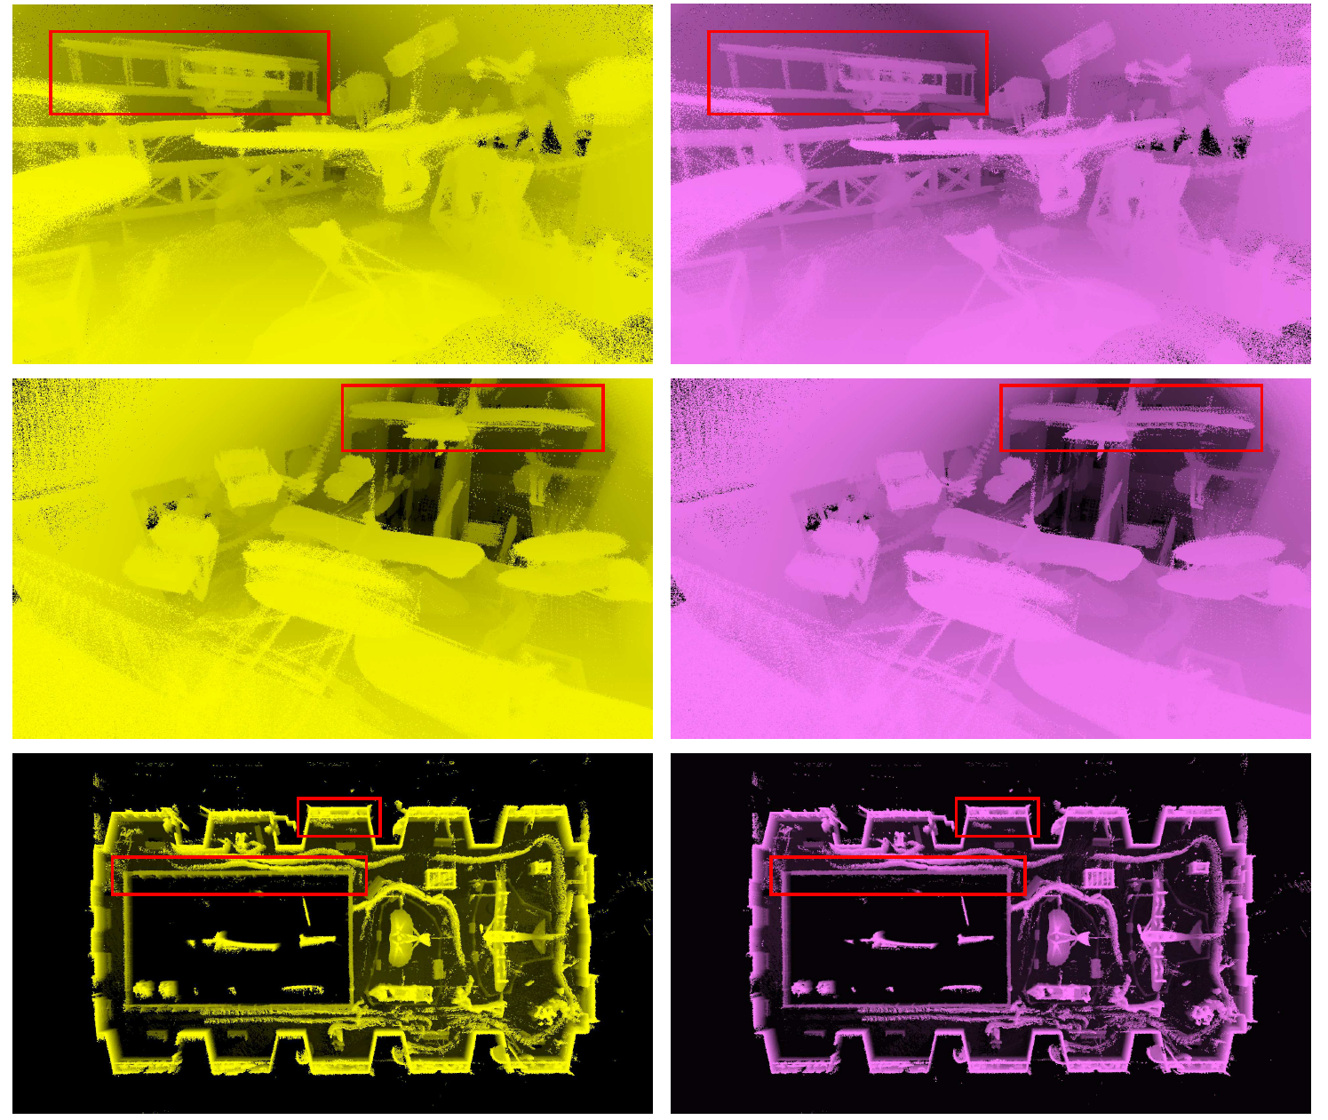

Slide 25
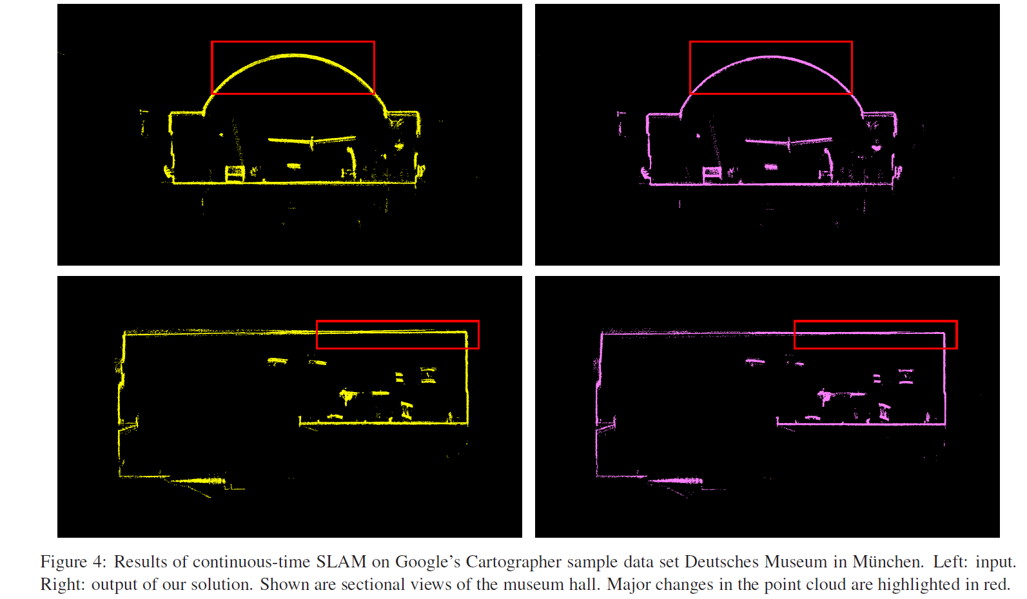

Slide 26
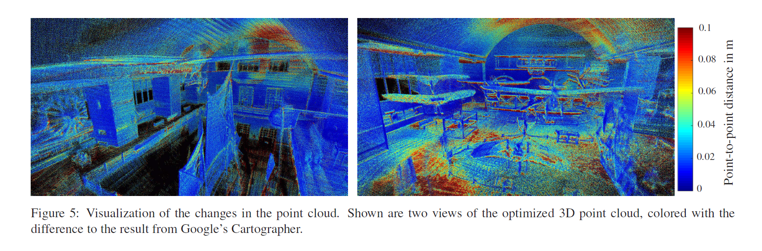

Slide 27
